Slide 1
Grails - Views

Slide 2
Agenda
Role of views in MVC
How view is evaluated and rendered by action
Page import and content type
Groovy scriptlets in gsp
Re-use of gsp code using templates
Built in grails tags

Slide 3
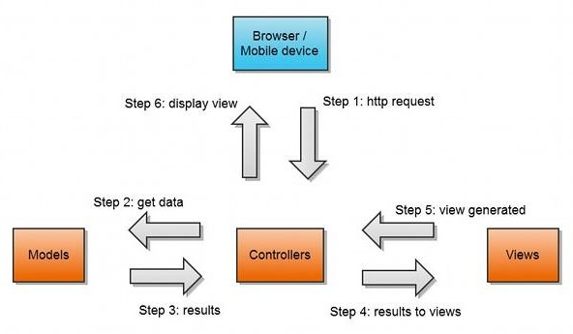
MVC Architecture

Slide 4
Rendering Views
Rendering a simple text:
render "Hello World!"
Render a specific view:
render(view: 'show')
Render a template for each item in a collection:
render(template: 'book_template', collection: Book.list())
Render some text with encoding and content type:
render(text: "<xml>some xml</xml>", contentType: "text/xml", encoding: "UTF-8")

Slide 5
Page Import and Content Type
The import directive lets you import classes into the page. However, it is rarely needed due to Groovy's default imports and GSP Tags:
<%@ page import="java.awt.*" %>
GSP also supports the contentType directive:
<%@ page contentType="application/json" %>

Slide 6
Groovy Scriptlets
GSP supports the usage of <% %> scriptlet blocks to embed Groovy code (again this is discouraged)
<html>
<body>
<% out << "Hello GSP!" %>
</body>
</html>
You can also use the <%= %> syntax to output values:
<html>
<body>
<%="Hello GSP!" %>
</body>
</html>

Slide 7
Groovy Scriptlets (contd…)
GSP also supports JSP-style server-side comments (which are not rendered in the HTML response) as the following example demonstrates:
<html>
<body>
<%-- This is my comment --%>
<%="Hello GSP!" %>
</body>
</html>

Slide 8
Templates
Template are the chunks of reusable gsp code.
They make the views maintainable for developer
Grails uses the convention of placing an underscore before the name of a view to identify it as a template
For example (a template for showing details of books can be):
// grails-app/views/book/_bookTemplate.gsp
<div class="book" id="${book?.id}">
<div>Title: ${book?.title}</div>
<div>Author: ${book?.author?.name}</div>
</div>

Slide 9
Rendering a template
Use the render tag to render this template from one of the views in grails-app/views/book:
<g:render template="bookTemplate" model="[book: myBook]"/>
For rendering shared template you have to use relative path to the template from inside the views folder: eg. for rendering grails-app/views/shared/_mySharedTemplate.gsp
<g:render template="/shared/mySharedTemplate" />

Slide 10
Template Namespace
Since templates are used so frequently there is template namespace, called tmpl, available that makes using templates easier. So,
<g:render template="bookTemplate" model="[book:myBook]" />
is equivalent to:
<tmpl:bookTemplate book="${myBook}" />

Slide 11
Built-in GSP Tags
There are many predefined GSP tags available to use in Grails.
All of them use namespace ‘g’. We will see this..
They are categorized into following categories:
* Logic Tags
* Iteration Tags
* Link Tags
* Form and Filed Tags

Slide 12
Logic Tags
//g:if , g:elseif, g:else
<g:if test="${session.role == 'superadmin'}">
<%-- show super administrative functions --%>
</g:if>
<g:elseif test=”${session.role == ‘admin'}”>
<%-- show administrative functions --%>
</g:elseif>
<g:else>
<%-- show basic functions --%>
</g:else>

Slide 13
Iteration Tags
// g:each
<g:each in="${[1,2,3]}" var="num">
<p>Number ${num}</p>
</g:each>
// g:while
<g:set var="num" value="${1}" />
<g:while test="${num < 5 }">
<p>Number ${num++}</p>
</g:while>

Slide 14
Link Tags
GSP also features tags to help you manage linking to controllers and actions
<g:link action="show" id="1">Book 1</g:link>
<g:link action="show" id="${currentBook.id}">${currentBook.name}</g:link>
<g:link controller="book">Book Home</g:link>
<g:link controller="book" action="list">Book List</g:link>
<g:link url="[action: 'list', controller: 'book']">Book List</g:link>
<g:link params="[sort: 'title', order: 'asc', author: currentBook.author]" action="list">Book List</g:link>

Slide 15
Form Tag
This is a controller/action aware version of the regular HTML form tag.
The url attribute lets you specify which controller and action to map to.
<g:form name="myForm" url="[controller:'book',action:'list']">...</g:form>

Slide 16
Form Fileds
Following form field tags are allowed :
textField - For input fields of type 'text'
field - number, password, uri
passwordField - For input fields of type 'password'
checkBox - For input fields of type 'checkbox'
radio - For input fields of type 'radio'
hiddenField - For input fields of type 'hidden'
select - For dealing with HTML select boxes
submitButton
actionSubmit

Slide 17

Coding Conventions

Slide 18
GSP Clean Code
Name should be in camel case.
Bad:
Generalinfo.gsp
Good:
generalInformation.gsp
generalInfo.gsp

Slide 19
GSP Clean Code
DO NOT write any GORM query in GSP Bad:
<g:each in=”${Person.list()}”>
//SOMETHING
</g:each>
Good:
All the data is sent from the action and gsp is used just for showing it.
//in controller
render view:’list’,model:[persons:Person.list()]
//in gsp
<g:each in=”${persons}”>
//SOMETHING
</g:each>

Slide 20
GSP Clean Code
DO NOT make database calls in layouts (Try to put such data which is used in layout either in session or in application context)
Typecast VO in gsp, so that you have all properties readily available for
<g:set var="vo" value="${vo as AccountVO}"/>
Make templates rather than having single big gsp file.
Write all the javascript in js files. It helps in caching, code is reusable, can be maintained easily.
Application level js file should be named as all.js / common.js / application.js
Avoid in-line styling

Slide 21
Questions??

Slide 22
• • • • • • • • • • • • • • • • • • • • • • • • • • • • • • • • • • • • • • • • • • • • • • • • • • • • • • • • • • • • • • • • • • • • • • • • • • • • • • • • • • • • • • • • • • • • • • • •
Thank you!!
• • • • • • • • • • • • • • • • • • • • • • • • • • • • • • • • • • • • • • • • • • • • • • • • • • • • • • • • • • • • • • • • • • • • • • • • • • • • • • • • • • • • • • • • • • • • • • • •

